Slide 1
Facial Emotion, Age and Gender Detection from Images
Siva Yogitha Mokkapati
Venkat Nihaal Akula
Deep Learning (Spring II, 2020)
Dr. Youakim Badr

Slide 2
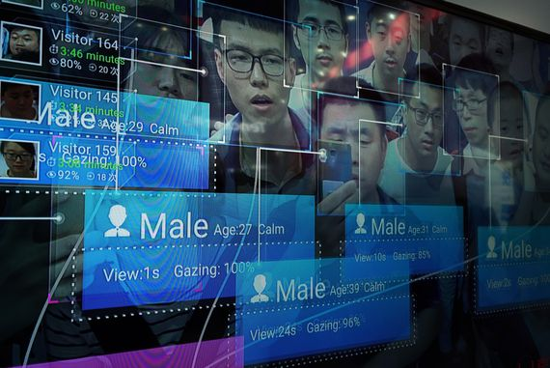
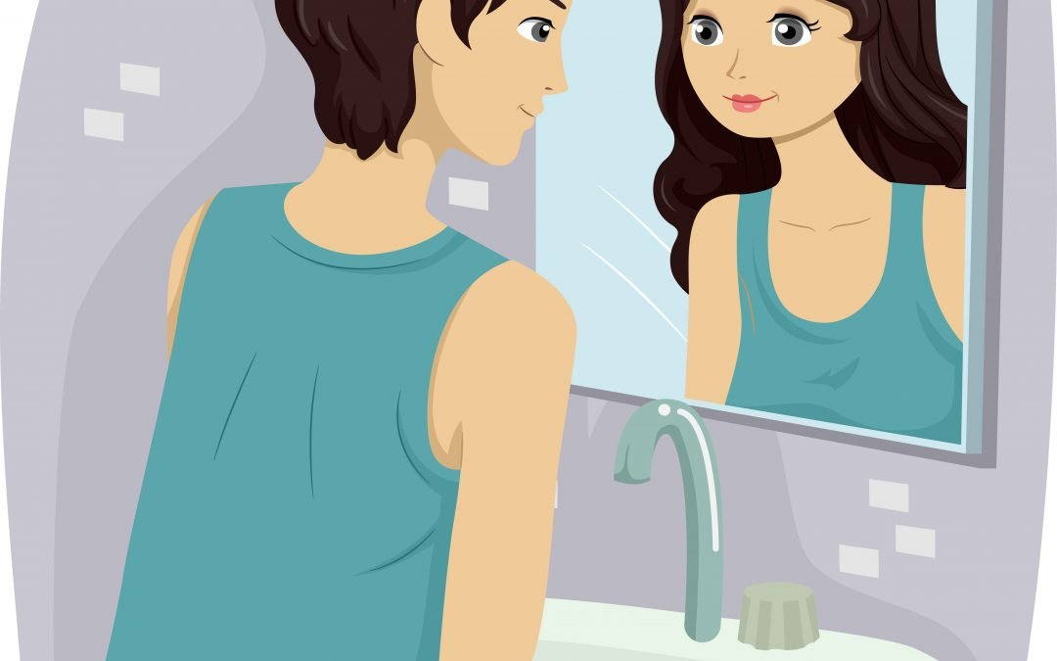
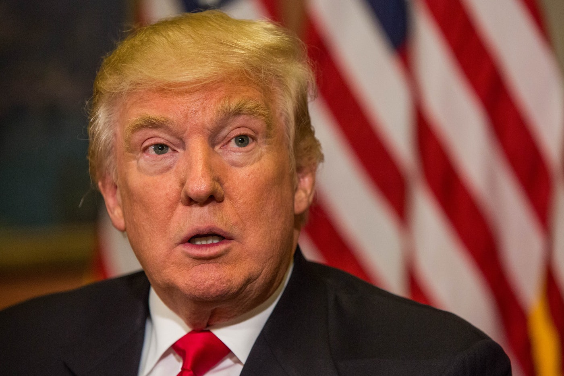
Context and Introduction
Emotion, Gender and Age Detection

Slide 3
Problem and Challenges
To construct an optimal model for Problem statement.
To apply transfer learning and check if it is able solve the problem of emotion, gender and age with a good accuracy.
To determine different class boundaries and its implications for age detection.
Use of different datasets for gender and age detection.

Slide 4
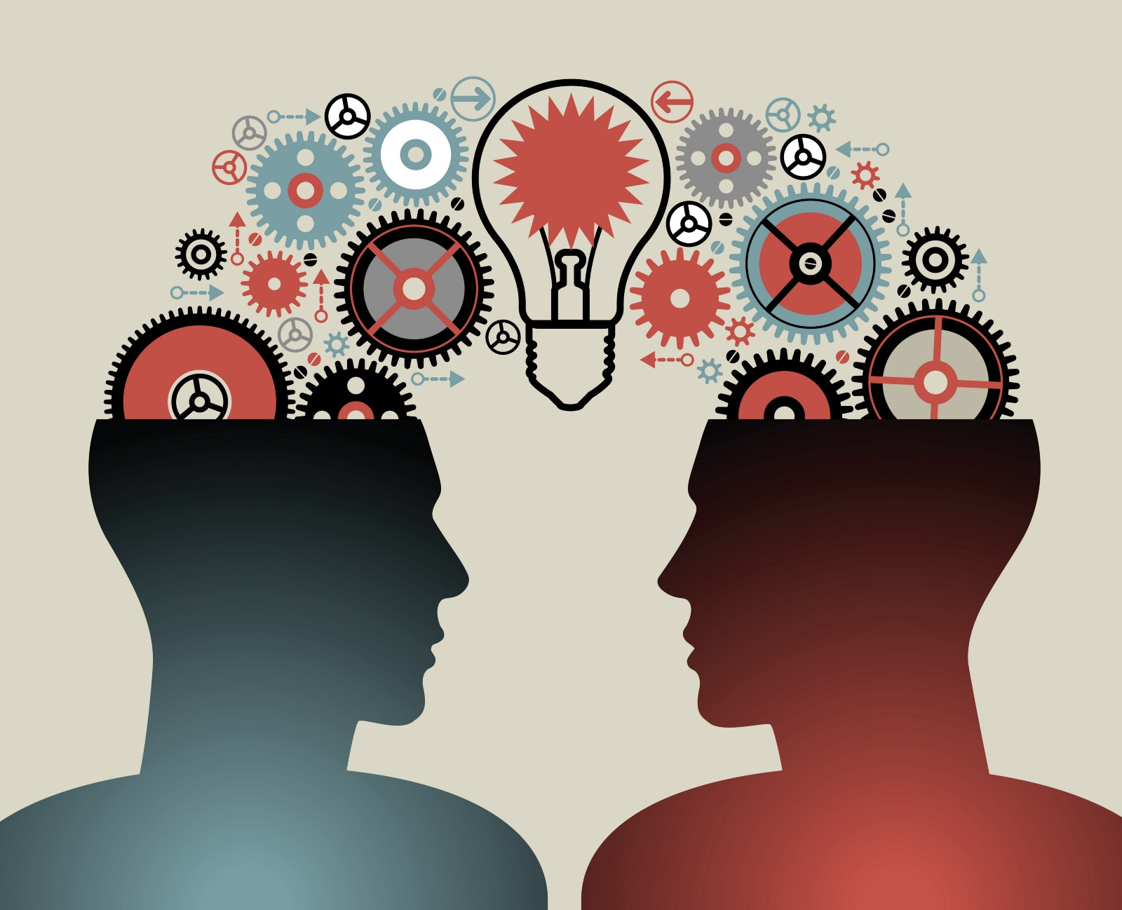
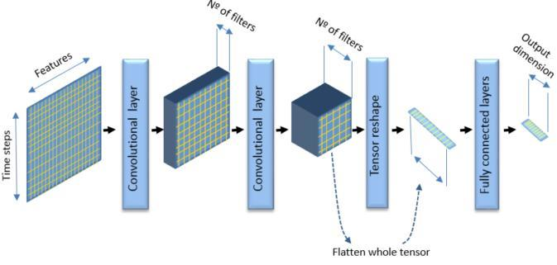

Related solutions / State of Art
The state of art and related solution for gender, age and emotion detection are to :
Apply transfer learning like VGG and RESNET

Slide 5
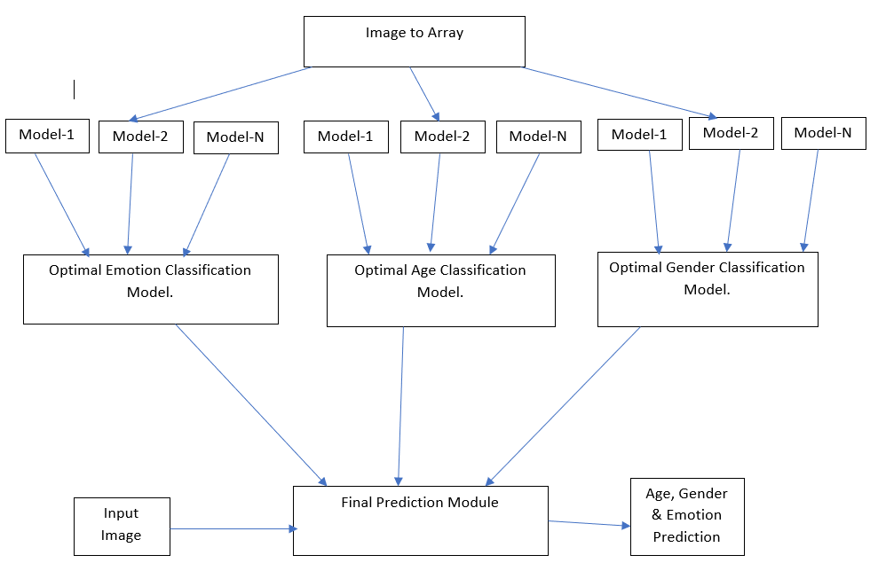
Overview of Solution

Slide 6
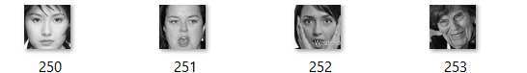
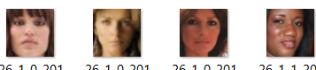
Data Collecting
The dataset for emotion classification is taken from FER Challenge posted in Kaggle.
The dataset has approximately 35000 records, with attributes image pixel array and emotion value. https://www.kaggle.com/c/challenges-in-representation-learning-facial-expression-recognition-challenge/data
The dataset for age and gender classification is taken from: https://susanqq.github.io/UTKFace/. It has approximately 23000 images.

Slide 7
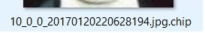
Data Preprocessing
For Emotion For age and Gender
String of pixels → Array of float → Age(10) and Gender (0)
Reshape
Normalization
Label Encoder

Slide 8
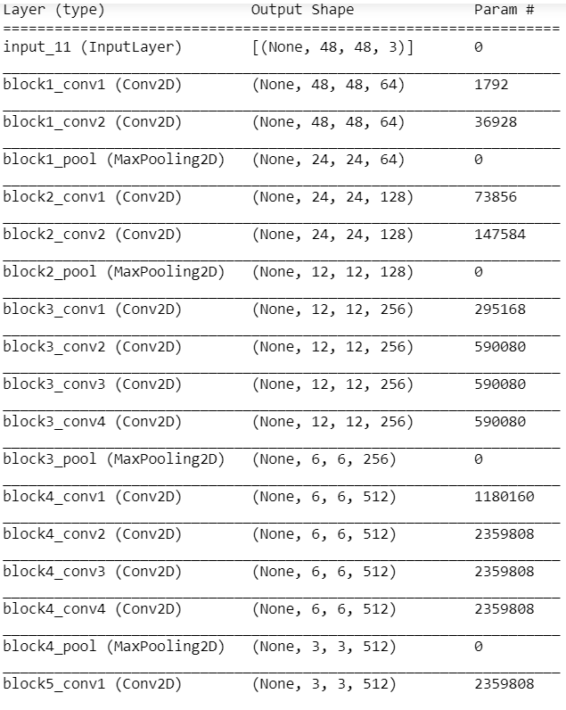
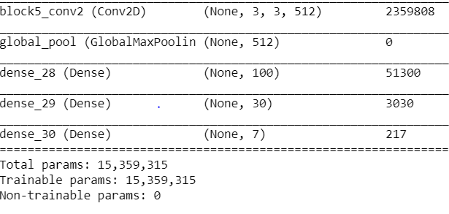
Models selection and parameters for emotion detection
Optimal Emotion Detection Model
Optimizer: Adam
Loss Function : Categorical Cross entropy
Data augmentation : ImageDataGenerator
Regularization: Drop out, Batch Normalization
Output Activation Function: Softmax
Activation Function: Elu
Kernel size: (3,3) and (5,5)
Kernel initializer: he_normal
Pooling Layers: Max Pooling (2D)

Slide 9
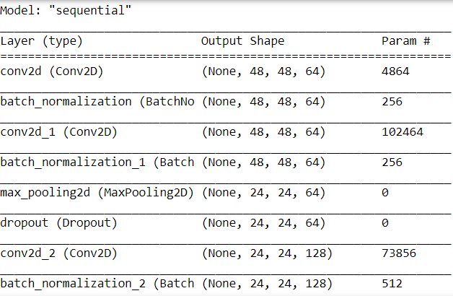
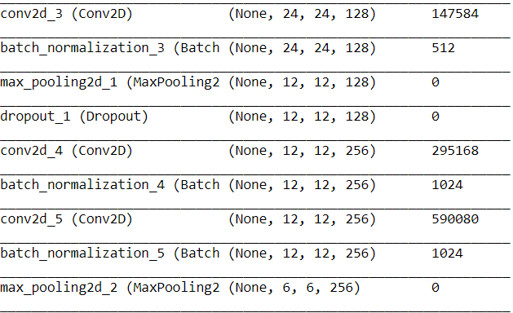
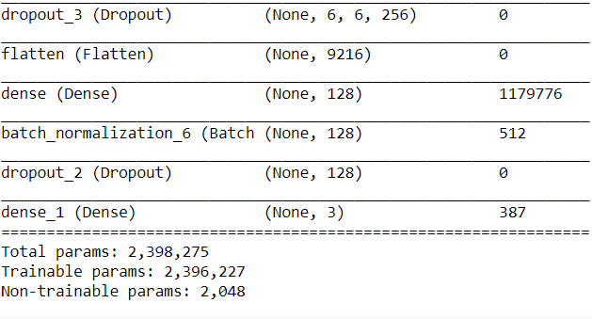
Models selection and parameters for age
Optimal Age Detection Model
Optimizer: Adam
Loss Function : Categorical Cross entropy
Regularization: Drop out, Batch Normalization
Output Activation Function: Softmax
Activation Function: Relu
Kernel size: (3,3) and (5,5)
Kernel initializer: he_normal
Pooling Layers: Max Pooling (2D)

Slide 10
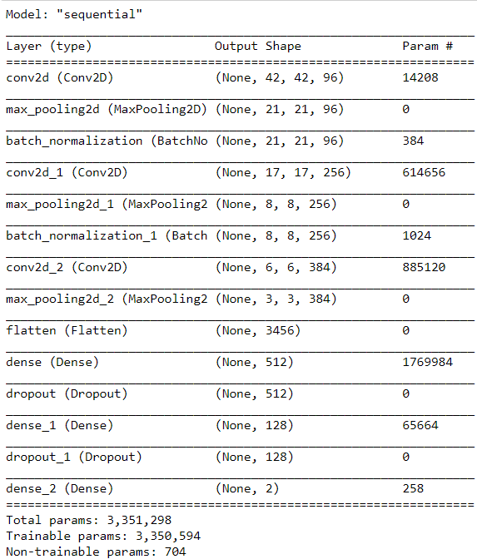
Models selection and parameters for gender
Optimal Gender Detection Model
Optimizer: Adam
Loss Function : Binary Cross entropy
Regularization: Drop out, Batch Normalization
Output Activation Function: Sigmoid
Activation Function: Relu
Kernel size: (3,3) , (5,5) and (7,7)
Pooling Layers: Max Pooling (2D)

Slide 11
Network Training – validation - testing
The dataset is divided into 80:20.
80% is used for model fitting and 20% is used as validation data for the model.
The same 20% is used for evaluating the model.

Slide 12
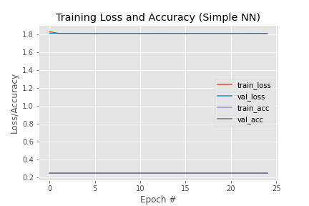
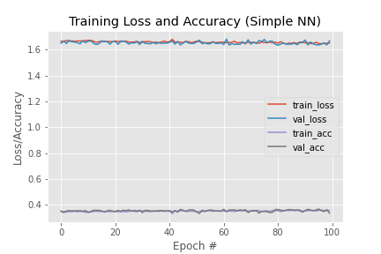
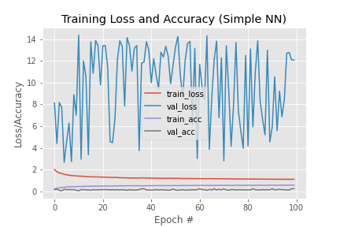
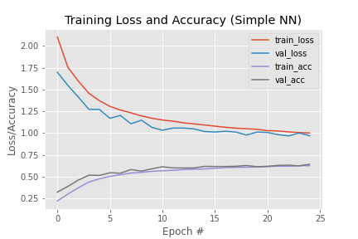
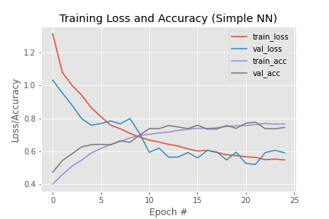
Evaluations/comparing for emotion
Vgg model
Model1
Model2
Model 4
Model 4 with top 3 emotions

Slide 13
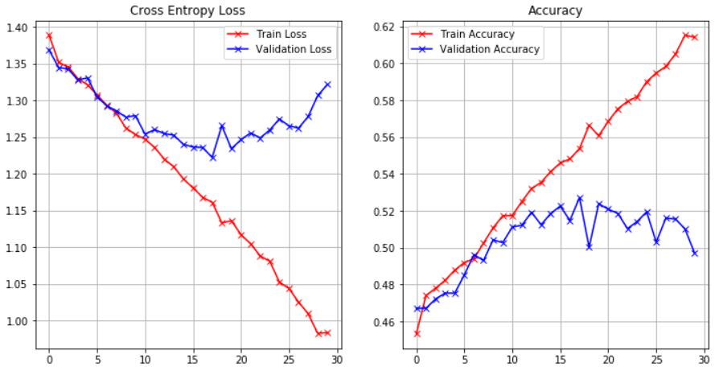
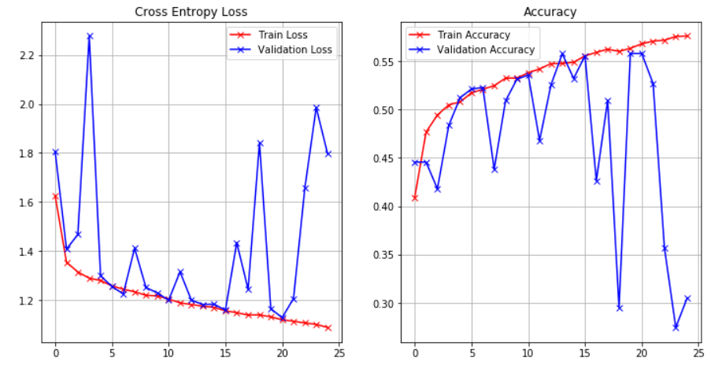
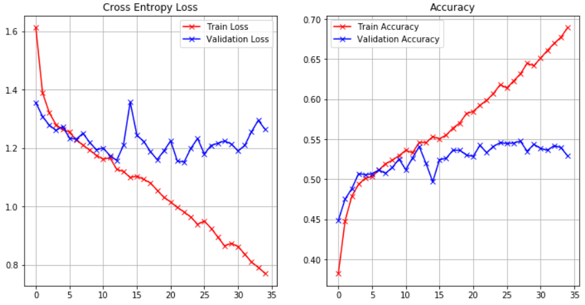
Evaluations/comparing for age
Model1
Model2
Optimal Model

Slide 14
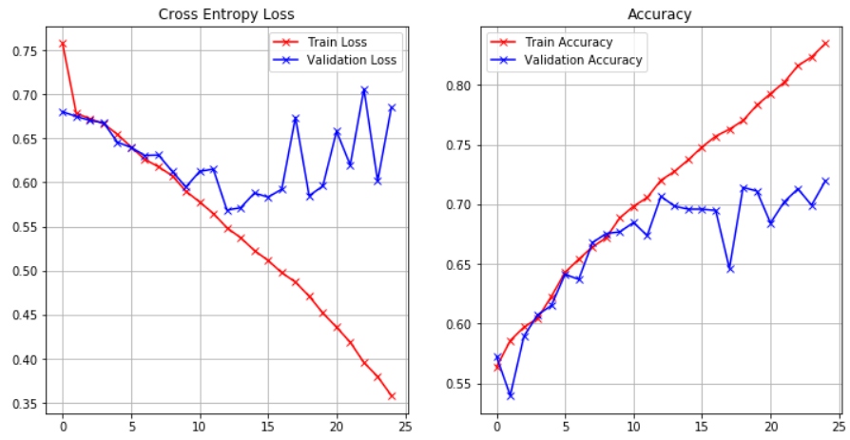
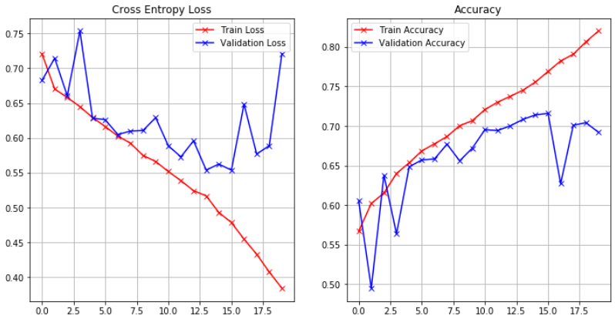
Evaluations/comparing for gender
Model1
Optimal Model

Slide 15
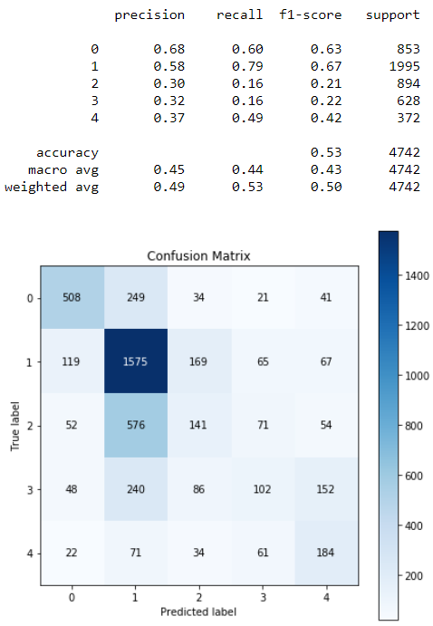
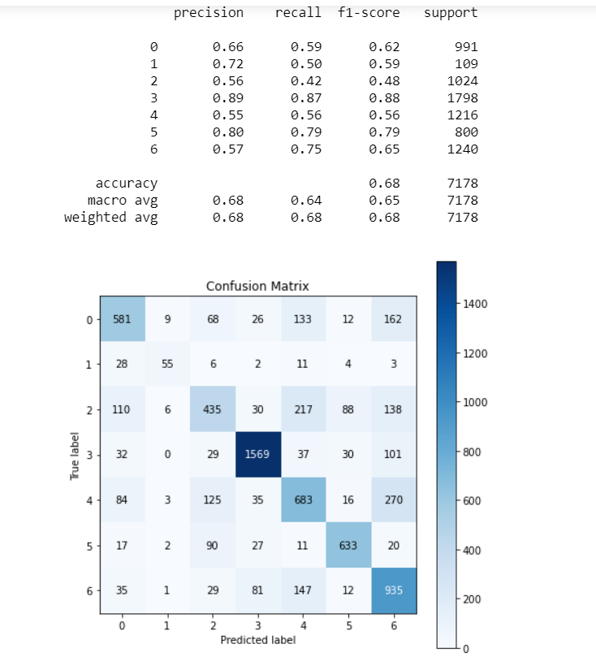
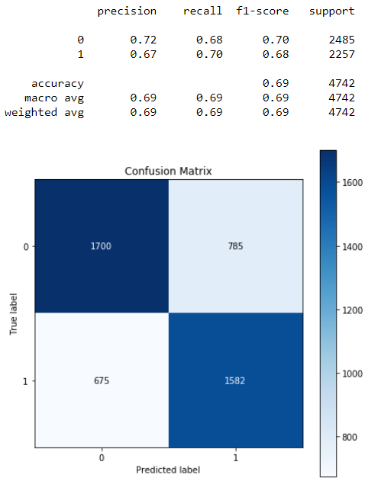
Performance metrics for the best model

Slide 16
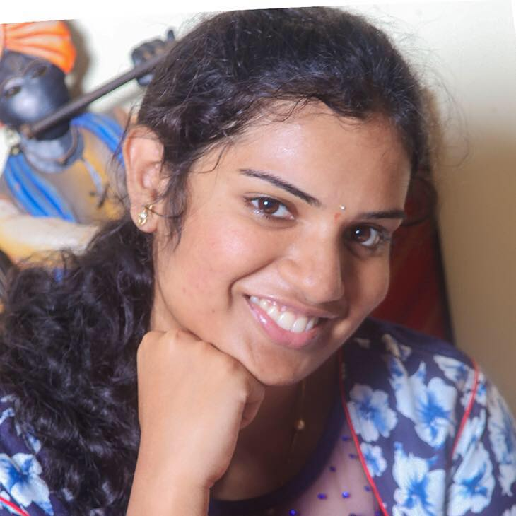
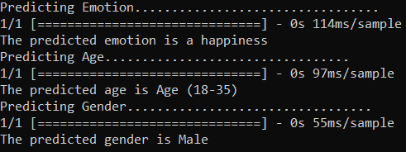
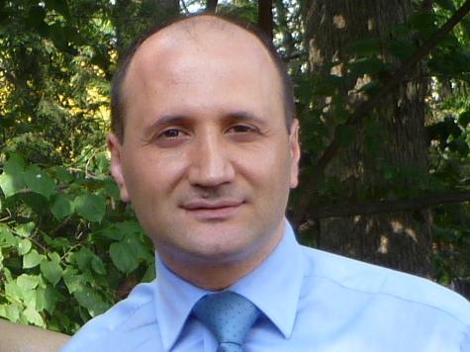
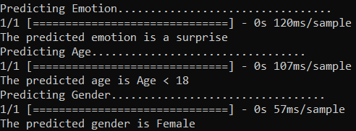
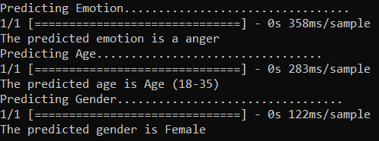
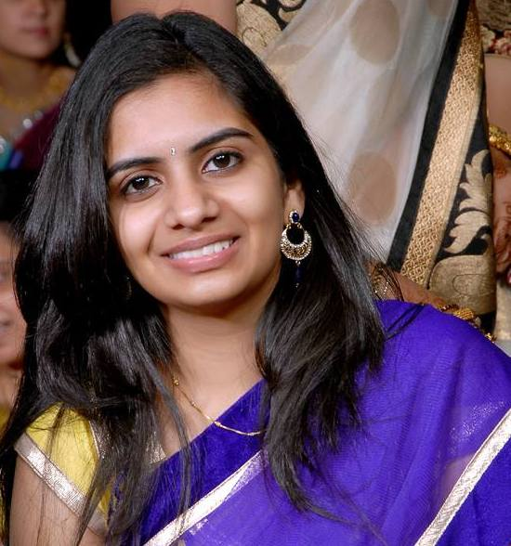
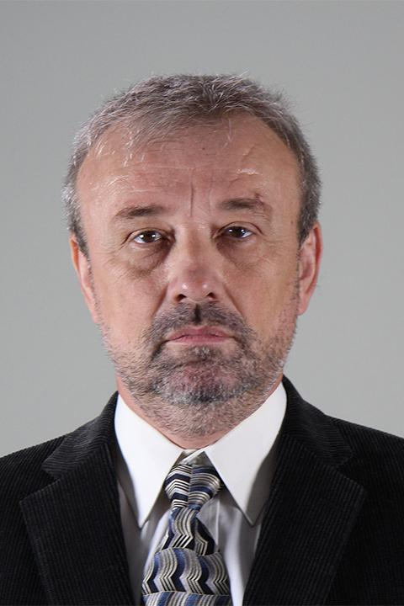
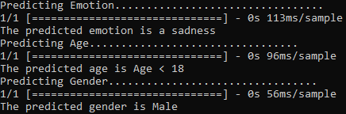
Outcomes/finding

Slide 17
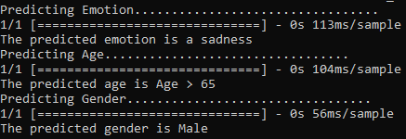
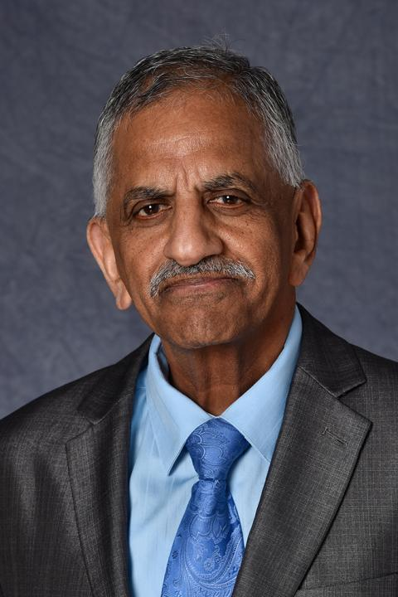
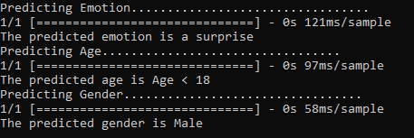

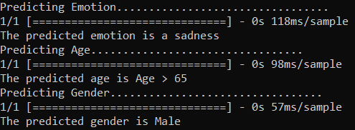
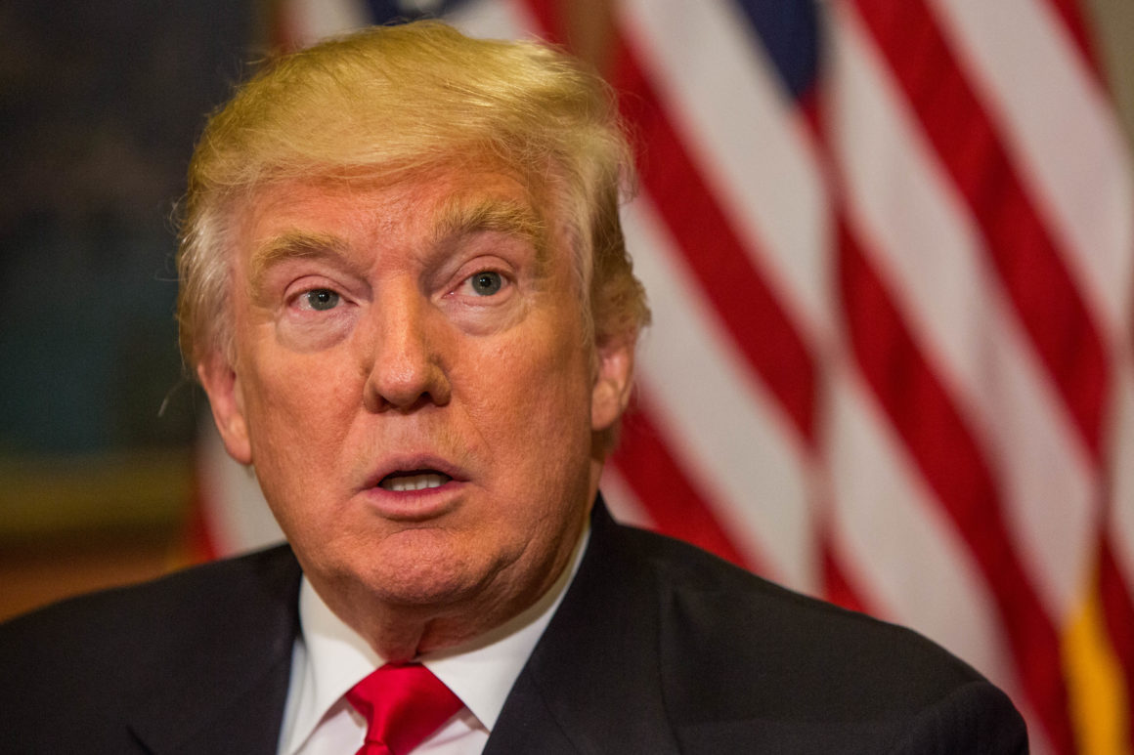
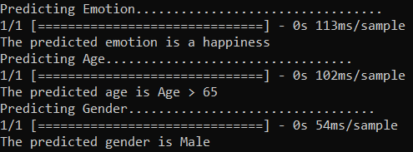
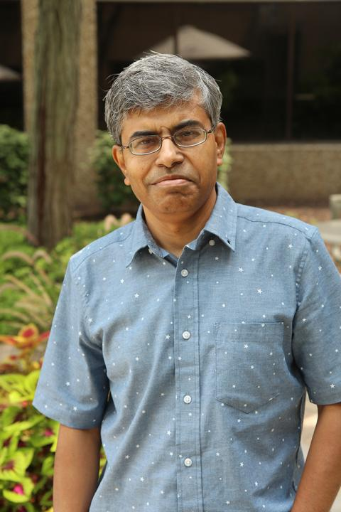
Outcomes/finding

Slide 18
Lessons learned and Perspectives
Understood how to build DNN and CNN models from base.
Learnt to apply transfer learning and to make changes as per required.
Understood the application of different activation functions and parameters.
Understood how to extract pixels from images and to preprocess image data.

Slide 19
Bibliographical References
Dehghan, Afshin & Ortiz, Enrique & Shu, Guang & Masood, Syed. (2017). DAGER: Deep Age, Gender and Emotion Recognition Using Convolutional Neural Network.
Özdemir, Mehmet & Elagoz, Berkay & Alaybeyoglu, Aysegul & Sadighzadeh, Reza & Akan, Aydin. (2019). Real Time Emotion Recognition from Facial Expressions Using CNN Architecture. 10.1109/TIPTEKNO.2019.8895215.
Bargal, Sarah & Barsoum, Emad & Ferrer, Cristian & Zhang, Cha. (2016). Emotion recognition in the wild from videos using images. 433-436. 10.1145/2993148.2997627.
Levi, Gil & Hassncer, Tal. (2015). Age and gender classification using convolutional neural networks. 34-42. 10.1109/CVPRW.2015.7301352.
Tal Hassner, Shai Harel, Eran Paz, Roee Enbar. Effective Face Frontalization in Unconstrained Image.
Slides and notebooks uploaded in canvas.
https://riptutorial.com/keras/example/32608/transfer-learning-using-keras-and-vgg
https://towardsdatascience.com/predict-age-and-gender-using-convolutional-neural-network-and-opencv-fd90390e3ce6
https://www.learnopencv.com/age-gender-classification-using-opencv-deep-learning-c-python/
https://www.researchgate.net/publication/225173459_Classification_of_Face_Images_for_Gender_Age_Facial_Expression_and_Identity
https://www.geeksforgeeks.org/image-classifier-using-cnn/

Slide 20


Venkat Nihaal Akula
Siva Yogitha Mokkapati

